Slide 1


Mentorness Project
DECODING GAMING BEHAVIOUR
Presented By
AJAY MENON
ajaymenon17@gmail.com

Slide 2
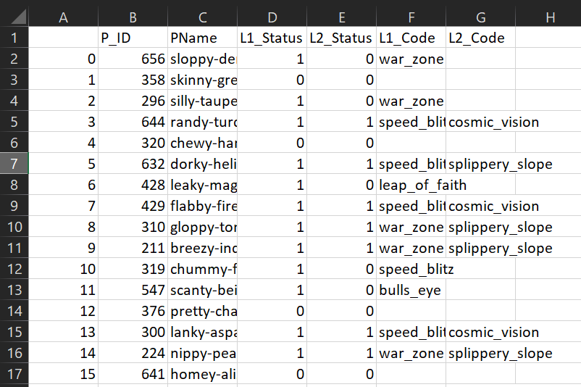
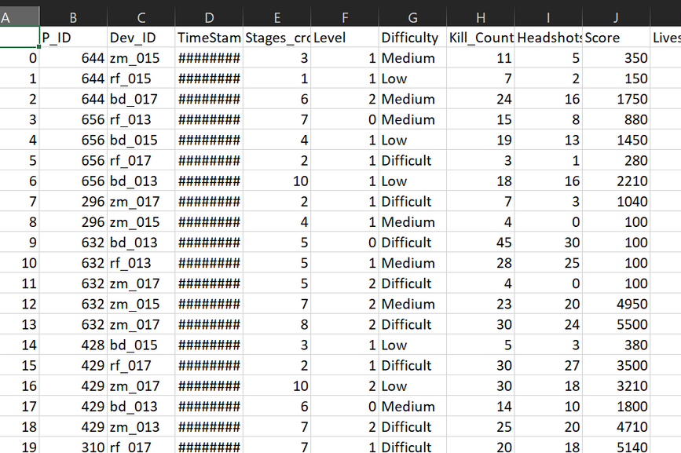
PLAYER DETAILS
The File contains informinformation about individual players within a game or gaming platform., P_ID: A unique identifier for each player.
PName: The name or username of the player.
L1_Status, L2_Status: Status indicators (e.g., completion status) for different levels such as Level 1 and Level 2.
L1_Code, L2_Code: Codes or descriptors related to the gameplay or achievements within specific levels.
LEVEL DETAILS
file is expected to contain data related to player interactions with specific levels within a game, which might include:
P_ID: Dev_ID: TimeStamp: Stages_croed
Level: Difficult Kill_Count, Headshots_Count
Score, Lives_Earned:

Slide 3
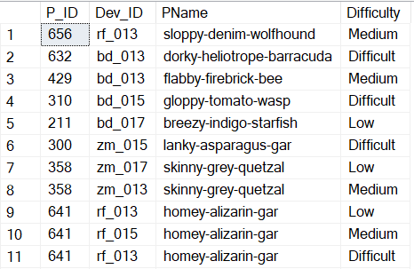
EXTRACT P_ID,DEV_ID,PNAME AND DIFFICULTY_LEVEL OF ALL PLAYERS
-- at level 0
SELECT pd.P_ID, ld.Dev_ID,
pd.PName,ld.Difficulty
FROM Game_Analysis.dbo.player_details pd
JOIN Game_Analysis.dbo.level_details2 ld ON pd.P_ID = ld.P_ID WHERE ld.Level = 0;

Slide 4
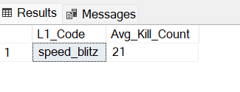
FIND LEVEL1_CODE WISE AVG_KILL_COUNT WHERE LIVES_EARNED IS 2 AND ATLEAST 3 STAGES ARE CROSSED
SELECTpd.L1_Code, AVG(ld.Kill_Count) AS Avg_Kill_Count
FROM Game_Analysis.dbo.player_details pd
JOIN Game_Analysis.dbo.level_details2 ld ON pd.P_ID = ld.P_ID
WHERE ld.Lives_Earned = 2 AND ld.Stages_crossed <= 3
GROUP BY pd.L1_code;

Slide 5
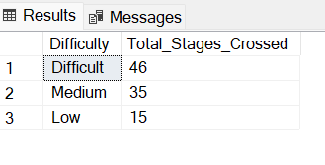
FIND THE TOTAL NUMBER OF STAGES CROSSED AT EACH DIFFUCULTY LEVELWHERE FOR LEVEL2 WITH PLAYERS USE ZM_SERIES DEVICES. ARRANGE THE RESULT N DECREASING ORDER OF TOTAL NUMBER OF STAGES CROSSED
SELECT ld.Difficulty, SUM(ld.Stages_crossed) as Total_Stages_Crossed
FROM Game_Analysis.dbo.level_details2 ld
JOIN Game_Analysis.dbo.player_details pd ON ld.P_ID = pd.P_ID
WHERE ld.Level = 2
AND ld.Dev_ID LIKE 'zm_%'
AND pd.L2_Status = 1
GROUP BY ld.Difficulty
ORDER BY Total_Stages_Crossed DESC;

Slide 6
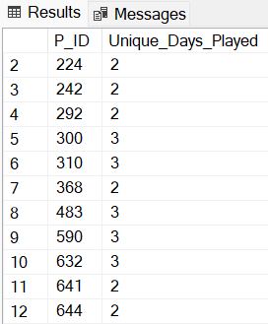
EXTRACT P_ID AND THE TOTAL NUMBER OF UNIQUE DATES FOR THOSE PLAYERS WHO HAVE PLAYED GAMES ON MULTIPLE DAY
SELECT ld.P_ID , COUNT( DISTINCT CONVERT(DATE, TimeStamp)) AS Unique_Days_Played
FROM Game_Analysis.dbo.level_details2 ld
GROUP BY ld.P_ID
HAVING COUNT(DISTINCT CONVERT(DATE,Timestamp))> 1

Slide 7
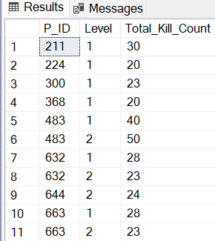
FIND P_ID AND LEVEL WISE SUM OF KILL_COUNTS WHERE KILL_COUNT IS GREATER THAN AVG KILL COUNT FOR THE MEDIUM DIFFICULTY
WITH AverageKill AS (
SELECT AVG(ld.Kill_Count) AS AvgKillCount
FROM Game_Analysis.dbo.level_details2 ld
WHERE ld.Difficulty = 'Medium')
SELECT ld.P_ID, ld.Level, SUM(ld.Kill_Count) AS Total_Kill_Count
FROM Game_Analysis.dbo.level_details2 ld, Averagekill ak
WHERE ld.Kill_Count > ak.AvgkillCount
AND ld.Difficulty = 'Medium'
GROUP BY ld.P_ID, ld.Level
ORDER BY ld.P_ID, ld.Level

Slide 8
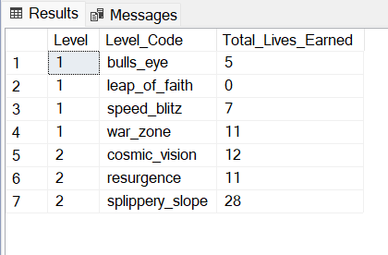
FIND LEVEL AND ITS CORRESPONDING LEVEL CODE WISE SUM OF LIVES EARNED EXCLUDING LEVEL 0. ARRANGE IN ASECENDING ORDER OF LEVEL.
SELECT ld.Level,
CASE
WHEN ld.Level = 1 THEN pd.L1_Code WHEN ld.Level = 2 THEN pd.L2_Code END AS Level_Code,
SUM(ld.Lives_Earned) AS Total_Lives_Earned
FROM Game_Analysis.dbo.level_details2 ld
JOIN Game_Analysis.dbo.player_details pd
ON pd.P_ID = ld.P_ID
WHERE ld.Level > 0
GROUP BY ld.Level,
CASE
WHEN ld.Level = 1 THEN pd.L1_Code
WHEN ld.Level = 2 THEN pd.L2_Code
END
ORDER BY ld.Level ASC

Slide 9
FIND TOP 3 SCORE BASED ON EACH DEV_ID AND RANK THEM IN INCREASING OR DERUSING ROW_NUMBER. DISPLAY DIFFICULTY AS WELL
SELECT
Dev_ID, Score, Difficulty,
ROW_NUMBER() OVER (PARTITION BY Dev_ID ORDER BY Score DESC) AS Rank
FROM Game_Analysis.dbo.level_details2
WHERE Rank <= 3
ORDER BY Dev_ID, Rank ASC
SELECT * FROM (
SELECT Dev_ID,Score, Difficulty,
ROW_NUMBER() OVER (PARTITION BY
Dev_ID ORDER BY Score DESC) AS Rank
FROM Game_Analysis.dbo.level_details2
) AS RankedScores
WHERE Rank <= 3
ORDER BY
Dev_ID, Rank ASC;

Slide 10
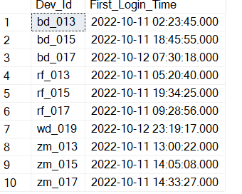
FIND FIRST_LOGIN DATETIME FOR EACH DEVICE ID
SELECT Dev_Id, MIN(TimeStamp) AS First_Login_Time
FROM Game_Analysis.dbo.level_details2
GROUP BY Dev_ID
ORDER BY Dev_ID;

Slide 11
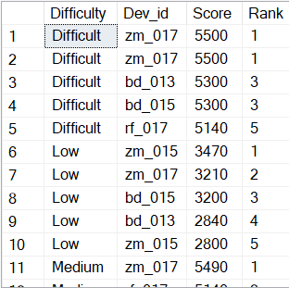
FIND TOP 5 SCORE BASED ON EACH DIFFICULTY LEVEL AND RANK THEM IN
-- INCREASING ORDER USING RANK. DISPLAY DEV_ID AS WELL
SELECT * FROM
( SELECT Difficulty, Dev_id, Score,
RANK() OVER (PARTITION BY
Difficulty ORDER BY Score DESC)
AS Rank
FROM Game_Analysis.dbo.level_details2
) As RankedScores
WHERE Rank <= 5
ORDER BY Difficulty, Rank;

Slide 12
FIND THE DEVICE ID THAT IS FIRST LOGGED IN(BASED ON START_DATETIME
FOR EACH PLAYER(P_ID). OUTPUT SHOULD CONTAIN PLAYER ID, DEVICE ID FIRST LOGIN DATETIME.
SELECT * FROM SELECT P_ID, Dev_ID, MIN(TimeStamp)
FROM Game_Analysis.dbo.level_details2
GROUP BY P_ID, Dev_ID ORDER BY P_ID, Dev_ID
WITH FirstLogins AS (SELECT P_ID, MIN(TimeStamp) AS First_Login_Time
FROM Game_Analysis.dbo.level_details2
GROUP BY P_ID
)
SELECT ld.P_ID.ld.Dev_ID, fl.First_Login_Time
FROM Game_Analysis.dbo.level_details2 AS ld
JOIN FirstLogins AS fl ON ld.P_ID = fl.P_ID AND ld.TimeStamp = fl.First_Login_Time;(

Slide 13
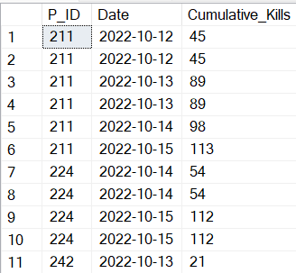
FOR EACH PLAYER AND DATE, HOW MANY KILL_COUNT PLAYED SO FAR BY THE PLAYER. THAT IS, THE TOTAL NUMBER OF GAMES PLAYED -- BY THE PLAYER UNTIL THAT DATE.
WINDOW FUNCTION
SELECT P_ID, CAST(TimeStamp AS DATE) AS Date,
SUM(Kill_Count) OVER (PARTITION BY P_ID ORDER BY CAST(TimeStamp AS DATE)) AS Cumulative_Kills
FROM
Game_Analysis.dbo.level_details2
ORDER BY
P_ID, Date;

Slide 14
FOR EACH PLAYER AND DATE, HOW MANY KILL_COUNT PLAYED SO FAR BY THE PLAYER. THAT IS, THE TOTAL NUMBER OF GAMES PLAYED -- BY THE PLAYER UNTIL THAT DATE.
WITHOUT WINDOW FUNCTION
SELECT
a.P_ID,
CAST(a.TimeStamp AS DATE) AS Date,
(SELECT SUM(b.Kill_Count)
FROM Game_Analysis.dbo.level_details2 b
WHERE b.P_ID = a.P_ID AND CAST(b.TimeStamp AS DATE) <= CAST(a.TimeStamp AS DATE)) AS Cumulative_Kills
FROM
Game_Analysis.dbo.level_details2 a
ORDER BY
a.P_ID, Date;

Slide 15
FIND THE CUMULATIVE SUM OF AN STAGES CROSSED OVER A START_DATETIME
SELECT P_ID, TimeStamp, Stages_crossed, SUM(Stages_crossed) OVER (PARTITION BY P_ID ORDER BY TimeStamp) AS Cumulative_Stages_Crossed
FROM Game_Analysis.dbo.level_details2
ORDER BY P_ID, TimeStamp

Slide 16
FIND THE CUMULATIVE SUM OF AN STAGES CROSSED OVER A START_DATETIME,FOR EACH PLAYER ID BUT EXCLUDE THE MOST RECENT START_DATETIME
WITH PlayerSessions AS (
SELECT P_ID, TimeStamp,Stages_crossed,
ROW_NUMBER() OVER (PARTITION BY P_ID ORDER BY TimeStamp DESC) AS LatestSessionRank,
SUM(Stages_crossed) OVER (PARTITION BY P_ID ORDER BY TimeStamp ROWS BETWEEN UNBOUNDED PRECEDING AND 1 PRECEDING) AS Cumulative_Stages
FROM Game_Analysis.dbo.level_details2
)

Slide 17
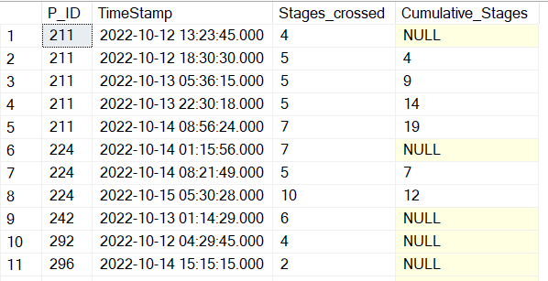
FIND THE CUMULATIVE SUM OF AN STAGES CROSSED OVER A START_DATETIME,FOR EACH PLAYER ID BUT EXCLUDE THE MOST RECENT START_DATETIME
SELECT P_ID, TimeStamp, Stages_crossed, Cumulative_Stages
FROM PlayerSessions
WHERE
LatestSessionRank > 1
ORDER BY
P_ID, TimeStamp;

Slide 18
EXTRACT TOP 3 HIGHEST SUM OF SCORE FOR EACH DEVICE ID AND THE CORRESPONDING PLAYER_ID
WITH ScoreSums AS (
SELECT Dev_ID, P_ID,
SUM(Score) AS TotalScore,
RANK() OVER (PARTITION BY Dev_ID ORDER BY SUM(Score) DESC) AS Rank
FROM
Game_Analysis.dbo.level_details2
GROUP BY
Dev_ID, P_ID
)
SELECT Dev_ID, P_ID, TotalScore
FROM ScoreSums
WHERE Rank <= 2
ORDER BY
Dev_ID, Rank;

Slide 19
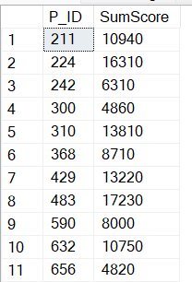
FIND PLAYERS WHO SCORED MORE THAN 50% OF THE AVG SCORE SCORED BY SUM OF
-- scores for each player_id
WITH TotalScores AS (
SELECT P_ID SUM(Score) AS SumScore
FROM Game_Analysis.dbo.level_details2
GROUP BY P_ID
),
AverageScore AS (
SELECT AVG(SumScore) AS AvgSumScore
FROM TotalScore
SELECT ts.P_ID, ts.SumScore
FROM TotalScores ts, AverageScore av
WHERE ts.SumScore > (av.AvgSumScore * 0.5)
ORDER BY
ts.P_ID;

Slide 20
CREATE A FUNCTION TO RETURN SUM OF SCORE FOR A GIVEN PLAYER_ID.
CREATE FUNCTION GetSumOfScores (@PlayerID INT)
RETURNS INT
AS
BEGIN
DECLARE @TotalScore INT;
SELECT @TotalScore = SUM(Score)
FROM Game_Analysis.dbo.level_details2
WHERE P_ID = @PlayerID;
RETURN @TotalScore;
END;
GO

Slide 21
THANK YOU
Further Info:
ajaymenon17@gmail,com

